Slide 1

CREDX RISK ANALYTICS CASE STUDY
BFS Capstone Project
Batch Jun-2018
By:
SHARATH ATHREY
SUMIT KAUSHIK
VANDHANA SHRI

Slide 2

Problem Statement:
CredX is a leading credit card provider that gets thousands of credit card applicants every year. But in the past few years, it has experienced an increase in credit loss. The best strategy to mitigate credit risk is to ‘acquire the right customers’.
Objective:
Identify the right customers
using predictive models.
Using past data of the bank’s
applicants, determine the factors
affecting credit risk.
Create strategies to mitigate the acquisition risk and assess the financial benefit of your project.

Slide 3

APPROACH TO SOLUTION
Business Understanding/Data Understanding
Data Preparation/EDA
Data Transformation/Model Building
Model Evaluation
Score Card Application

Slide 4

DATA UNDERSTANDING
Two Datasets provided namely,
Demographic Data:
Information provided by the
applicants at the time of
Credit card application.
Credit Bureau Data :
It provides all details of past
transaction taken from the
credit bureau.
DEMOGRAPHIC DATA | CREDIT BUEREAU DATA
Application ID | Application ID
Age | No of times 90/60/30 DPD or worse in last 6 months
Gender | No of times 90/60/30 DPD or worse in last 12 months
Income | No of Trades opened in last 6/12 Months
Marital status | No of PL Trades opened in last 6/12 Months
Education | Total Number of trades
Profession | No of Inquiries in last 6/12 Months (Excl Home/Auto Loans)
Number of dependants | Presence of open Home/Auto Loan
Number of Months in Curreny Company | Avg CC Utilzation in last 12 months
Number of Months in Curreny Residence | Outstanding Balance
Performance Tag | Performance Tag
TARGET VARIABLE with values:
0-Non-Default,1-Default

Slide 5

ASSESSING DATA QUALITY
OBSERVATIONS:
71295 rows in both datasets
Common Unique Variable - Application ID
Target variable -Performance Tag
3 Duplicate Application ID’s
Observed -Excluded from
further analysis
 | Variables | NA's Found | Others
 | Performance Tag | 1425 in both Datasets -excluded from further analysis
DEMOGRAPHIC | Age |  | 65 with Age <18- Capped to 18
 | Income |  | with Income <0-
 | Gender | 2
 | Marital Status | 6
 | No of dependents | 3
 | Education | 118
 | Profession | 13
 | Type of residence | 8
CREDIT | Avgas CC Utilization in last 12 months | 1058
 | No of trades opened in last 6 months | 1
 | Presence of open home loan | 272
 | Outstanding Balance | 272

Slide 6
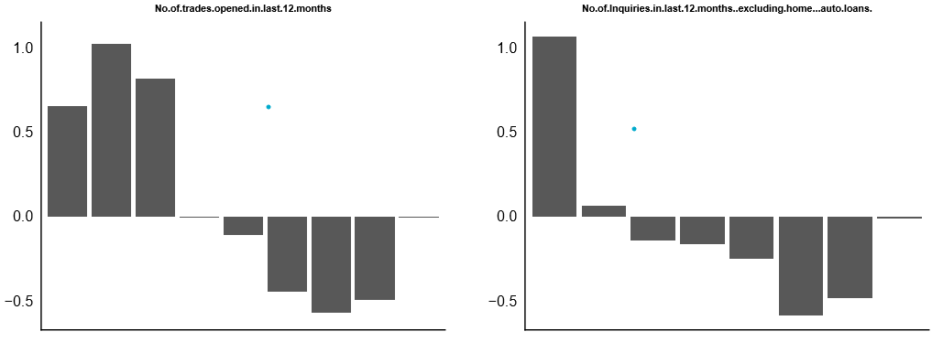
WEIGHT OF EVIDENCE(WOE)
Compute predictive power of a variable in relation to the dependent variable.
Impute missing values
Handle outliers
INFORMATION VALUE (IV)
Select and rank the most important variables in a predictive model
No variables from Demographic dataset play a significant role.

Slide 7
Information Value Analysis
Variable | IV
Avgas.CC.Utilization.in.last.12.months | 0.310
No.of.trades.opened.in.last.12.months | 0.298
No.of.PL.trades.opened.in.last.12.months | 0.296
No.of.Inquiries.in.last.12.months..excluding.home...auto.loans. | 0.295
Outstanding.Balance | 0.246
No.of.times.30.DPD.or.worse.in.last.6.months | 0.242
Total.No.of.Trades | 0.237
No.of.PL.trades.opened.in.last.6.months | 0.220
No.of.times.90.DPD.or.worse.in.last.12.months | 0.214
No.of.times.60.DPD.or.worse.in.last.6.months | 0.206
No.of.Inquiries.in.last.6.months..excluding.home...auto.loans. | 0.205
No.of.times.30.DPD.or.worse.in.last.12.months | 0.198
No.of.trades.opened.in.last.6.months | 0.186
No.of.times.60.DPD.or.worse.in.last.12.months | 0.185
No.of.times.90.DPD.or.worse.in.last.6.months | 0.160
No.of.months.in.current.residence | 0.079
Income | 0.042
No.of.months.in.current.company | 0.022
Presence.of.open.home.loan | 0.018
Age | 0.003
No.of.dependents | 0.003
Profession | 0.002
Presence.of.open.auto.loan | 0.002
Application.ID | 0.002
Education | 0.001
Gender | 0.000
Type.of.residence | 0.000
Marital.Status..at.the.time.of.application. | 0.000
Only variables with IV > 0.02 are considered for model building.

Slide 8
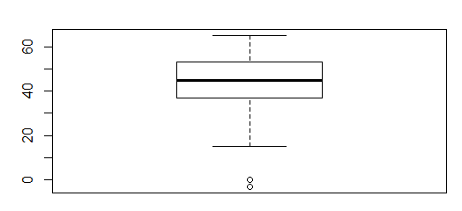
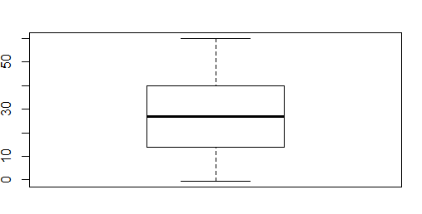
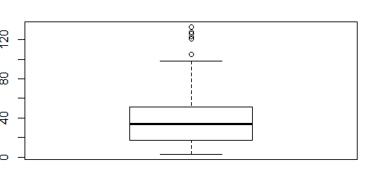
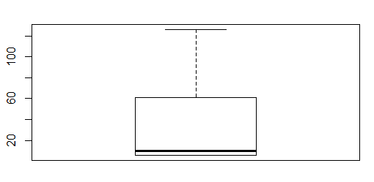
EDA-UNIVARIATE ANALYSIS
DEMOGRAPHIC DATA
45
27
Age
Income
34
10
No of Months in Current Company
No of months in current Residence
Few Outliers in Age, No of months in current Company

Slide 9
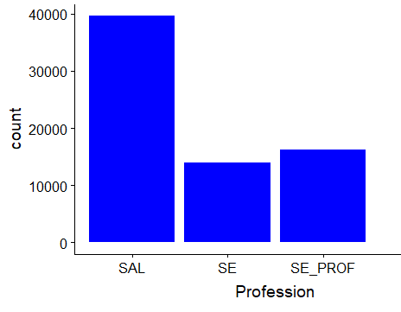
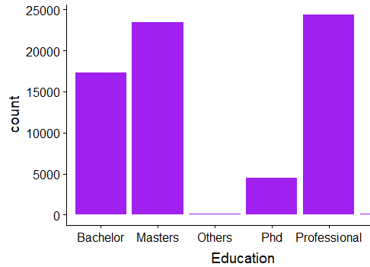
EDA-UNIVARIATE ANALYSIS
DEMOGRAPHIC DATA
Salaried Professionals apply for credit card more.
Those with professional degree apply for credit card in large numbers

Slide 10
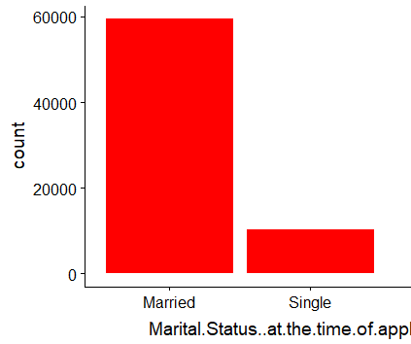
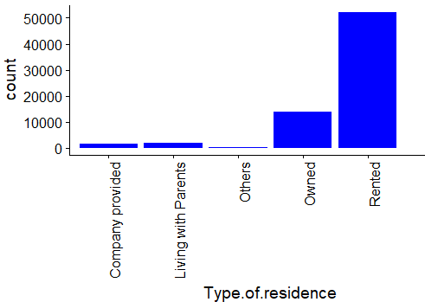
EDA-UNIVARIATE ANALYSIS
DEMOGRAPHIC DATA
Applicants who are married are higher in number
Those who are in rented accommodation tend to apply for credit cards in large numbers

Slide 11
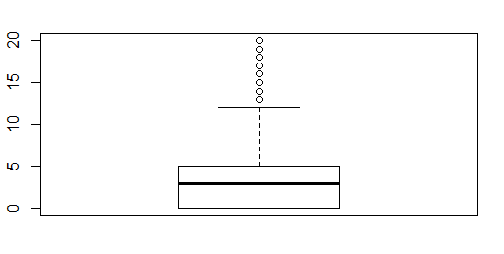
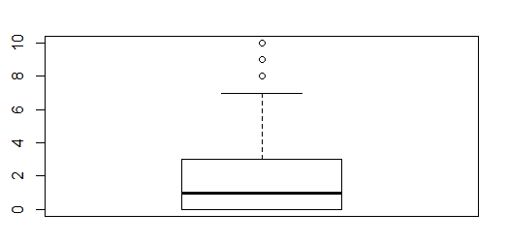
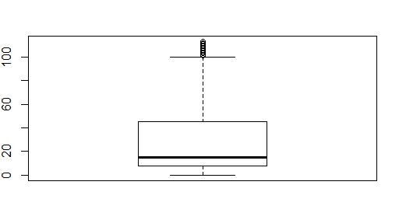
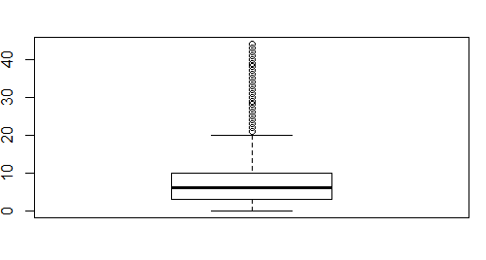
EDA-UNIVARIATE ANALYSIS
CREDIT DATA
3
1
Number of Inquiries in last 12 Months
No of Inquiries in the last 6 months
15
6
Avgas CC utilization
Total number of Trades

Slide 12
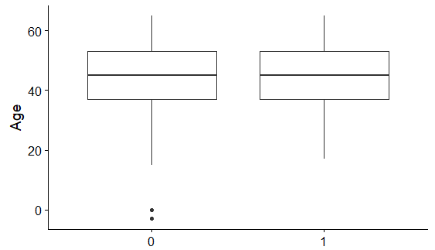
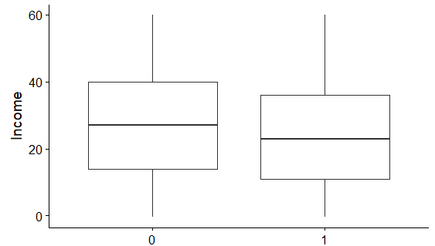
EDA-BIVARIATE ANALYSIS
DEMOGRAPHIC DATA
Age does not make a difference in default parameter
Applicants with a slightly lower income tend to default

Slide 13
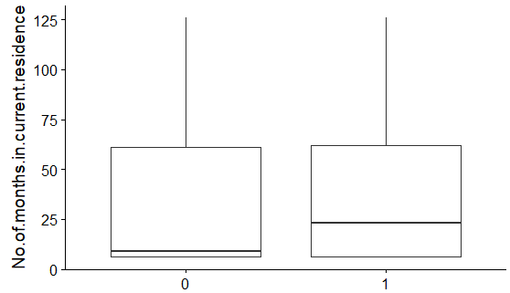
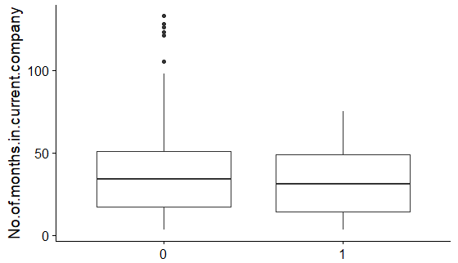
EDA-BIVARIATE ANALYSIS
DEMOGRAPHIC DATA
People with higher residence tenure default more
Tenure in a company doesn’t play a role in default rate

Slide 14
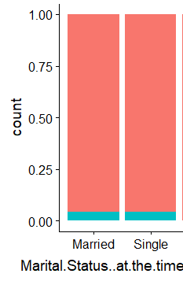
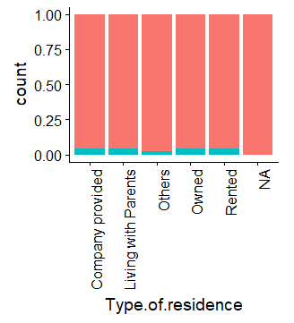
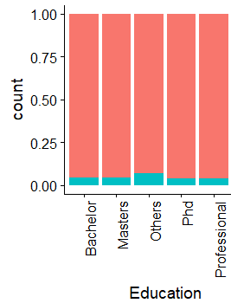
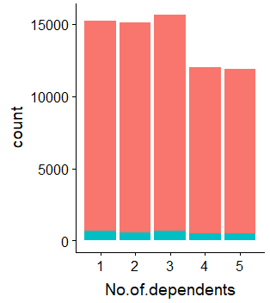
EDA-BIVARIATE ANALYSIS
DEMOGRAPHIC DATA
None of the above influence the parameter default rate

Slide 15
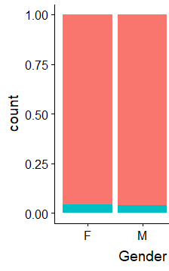
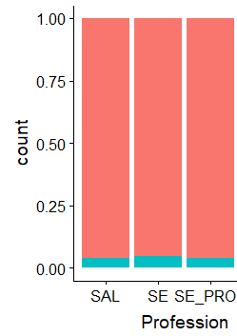
EDA-BIVARIATE ANALYSIS
DEMOGRAPHIC DATA
Both Gender and Profession does not affect default rate

Slide 16
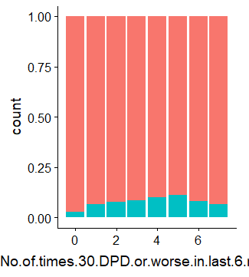
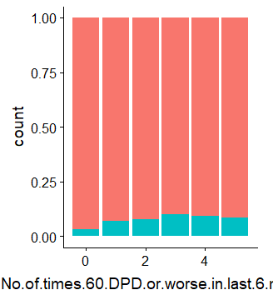
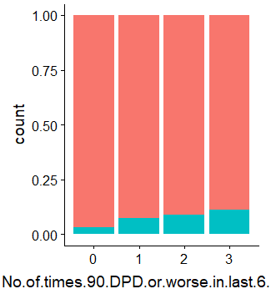
EDA-BIVARIATE ANALYSIS
CREDIT DATA
There is a similar trend observed in No of Times 30/60/90 DPD or worse in last six months and hence can be an important predictor.

Slide 17
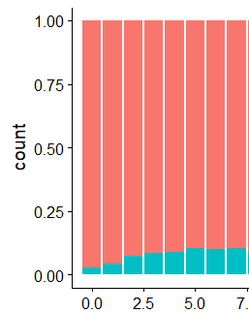
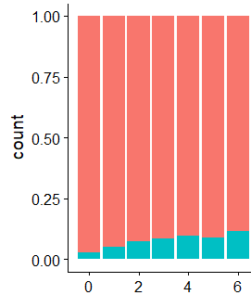
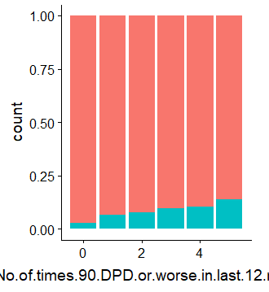
EDA-BIVARIATE ANALYSIS
CREDIT DATA
No of times 30 DPD in last 12 mon
No of times 60 DPD in last 12 mon
With increase in number of times times 30/60/90 DPD or worse in last 12 mon there is increase in default rate

Slide 18
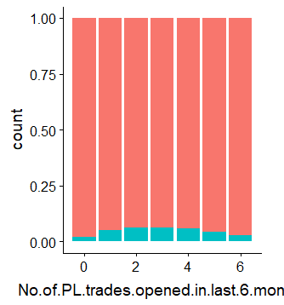
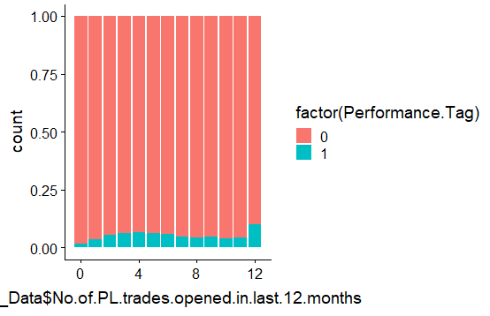
EDA-BIVARIATE ANALYSIS
CREDIT DATA
Percentage of defaulters increases with increase in number of PL trades opened in last 6 months till the 4th month and then decreases.
Percentage of defaulters is highest amongst applicants who opened 12 PL Trades in last 12 months.

Slide 19
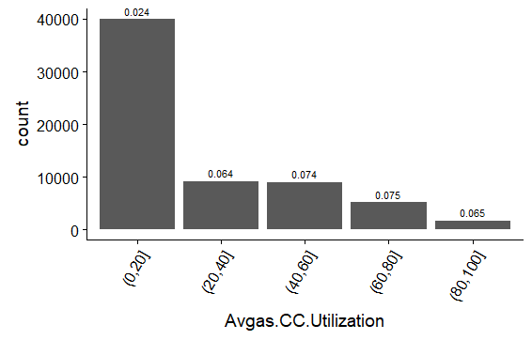
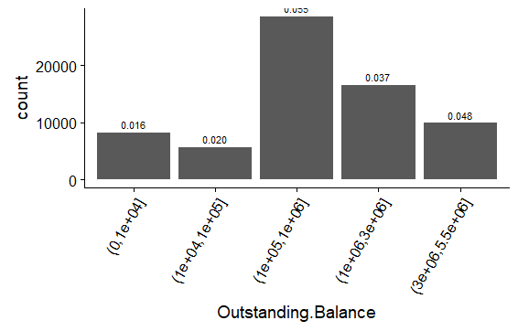
EDA-BIVARIATE ANALYSIS
CREDIT DATA
Defaulters are higher in lower credit card utilization band
Defaulters are higher in mid outstanding balance band

Slide 20
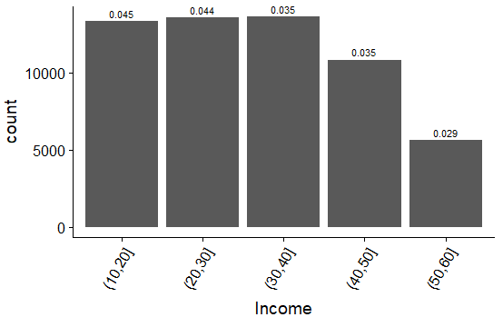
EDA-BIVARIATE ANALYSIS
CREDIT DATA
Defaulters reduce at a higher income band of(40-50) and (50-60) but not much difference in trend is observed in lower income bands
Better insights could be obtained from CREDIT DATA in comparison with DEMOGRAPHIC DATA

Slide 21
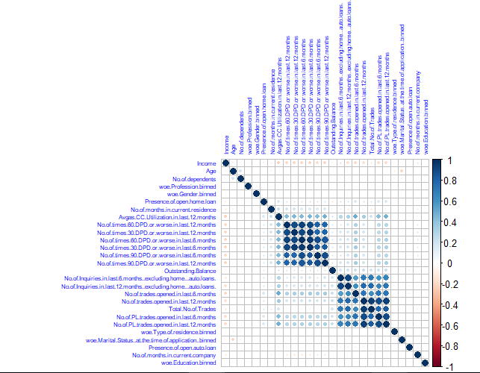
CORRELATION PLOT ON MERGED DATA
Data merged using “Application ID” as common field for join
2 Groups of data having positive correlation with each other..
No.of.times.90.DPD.or.worse.in.last.6.months
No.of.times.60.DPD.or.worse.in.last.6.months No.of.times.30.DPD.or.worse.in.last.6.months No.of.times.90.DPD.or.worse.in.last.12.months No.of.times.30.DPD.or.worse.in.last.12.months No.of.times.60.DPD.or.worse.in.last.12.months Avgas.CC.Utilization.in.last.12.month
No.of.trades.opened.in.last.6.months No.of.PL.trades.opened.in.last.6.mon No.of.PL.trades.opened.in.last.12.mon No.of.trades.opened.in.last.12.months
Total.No.of Trades
No.of.Inquiries.in.last.12.mon
No.of.Inquiries.in.last.6.months

Slide 22
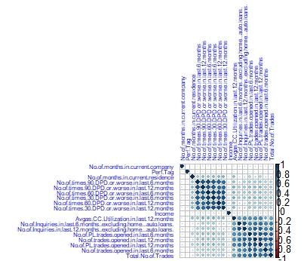
CORRELATION PLOT ON MERGED DATA
For variables with IV > 0.02

Slide 23
MODEL BUILDING DEMOGRAPHIC DATA
OUTLIER TREATMENT: Outlier detection is done using boxplot on continuous variables and quantiles function and the variables
with outliers has been corrected by capping the outliers to the nearest non-outlier values.
DATA SPLIT: The final dataset is split into Train and Test in 70:30 ratio for model building.
All models are trained on training datasets and regularization
was done by tuning of hyper parameters with cross validation
on validation datasets.
All the models are tested on test datasets that were kept
separate from training and validation datasets.
DATA SAMPLING: The given data is highly imbalanced. We have sampled data using ROSE package for balancing the training data sets.
The cutoff value for the probability of default was chosen such that model evaluation metrics like accuracy ,sensitivity and specificity were almost equal to each other.
Logistic Regression was built by iteratively removing using these two algorithms
1. Stepwise variable selection based on AIC[using stepAIC()]
2. Backward variable selection based on VIF and p value

Slide 24
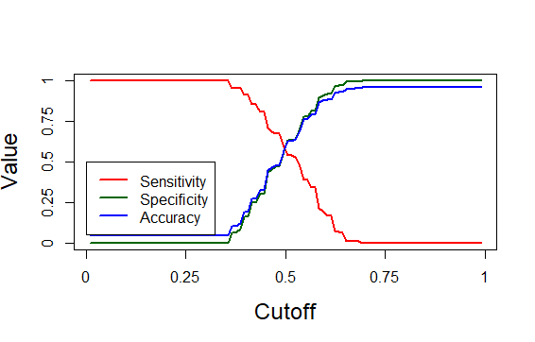
LOGISTIC REGRESSION-DEMOGRAPHIC DATA
Important Predictors:
WOE.No of months in current residence Binned
WOE No of months in current company binned
WOE Income Binned
Statistics | Values
Cut-off | 0.495
Accuracy | 57%
Sensitivity | 59%
Specificity | 57%
Thus a logistic regression model based only on demographic data seems to have low performance. Hence lets build a model with both demographic and credit data merged.

Slide 25
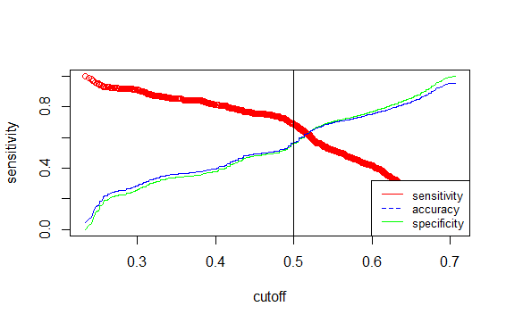
LOGISTIC REGRESSION-MERGED DATA
Important Predictors:
Income
No of Months in current company
No of times 90 DPD or worse in last 12 months
No of times 60 DPD or worse in last 12 months
No of times 30 DPD or worse in last 12 months
Avg CC Untilization in last 12 months
No of trades opened in last 6 months
No of PL trades opened in last 12 months
No of Inquiries in last 12 months excl home and auto loans
Confusion Matrix:
Prediction | No | Yes
No | 12732 | 340
Yes | 7343 | 544
KS-Statistic-25%
Statistics | Values
Cut-off | 0.52
Accuracy | 63%
Sensitivity | 62%
Specificity | 63%

Slide 26
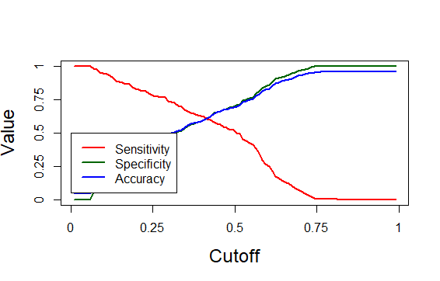
RANDOMN FOREST MODEL FOR MERGED DATA
Random Forest model is also applied to check if it performs better in comparison with logistic regression model
Statistics | Values
Cut-off | 0.
Accuracy | 62%
Sensitivity | 62%
Specificity | 61%
Confusion Matrix
Prediction | No | Yes
No | 12522 | 353
Yes | 7553 | 531
Since performance of the model is not as expected, let us try neural network.

Slide 27
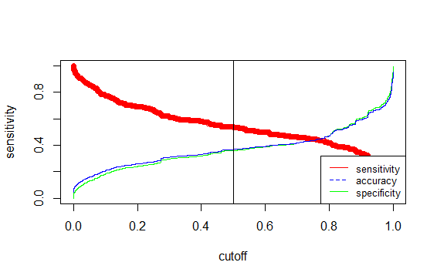
NEURAL NETWORK
Neural network is applied to check if it performs better in comparison with logistic regression model
Accuracy 43%
CONCLUSION:
Logistic Regression model on merged data is the final model for Application Scorecard.

Slide 28
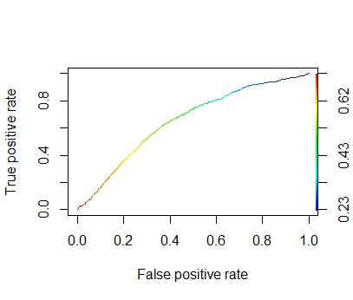
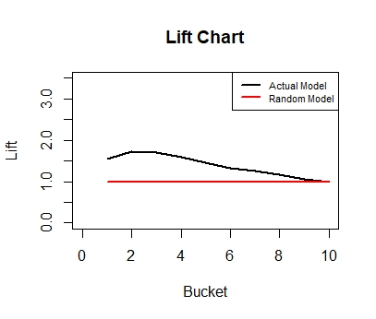
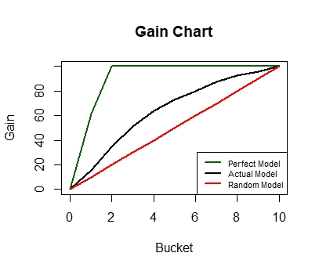
LOGISTIC REGRESSION-MERGED DATA
ROC Curve for final model:
Gain and Lift Charts
bucket total totalresp Cumresp Gain Cumlift
<int> <int> <dbl> <dbl> <dbl> <dbl>
1 1 2096 136 136 15.4 1.54
2 2 2096 170 306 34.6 1.73
3 3 2096 146 452 51.1 1.70
4 4 2096 113 565 63.9 1.60
5 5 2096 79 644 72.9 1.46
6 6 2096 62 706 79.9 1.33
7 7 2096 67 773 87.4 1.25
8 8 2096 47 820 92.8 1.16
9 9 2096 28 848 95.9 1.07
10 10 2095 36 884 100 1
By 5th decile 72.9% defaulters will be identified.

Slide 29

MODEL EVALUATION USING REJECTED DATA
Merge rejected data(those without Performance Tag) from DEMOGRAPHIC &CREDIT Data using Application ID
35 NA’s Observed inAvgas.CC.Utilization.in.last.12.months-Excluded
With a cutoff of 0.52 for the logistic regression model, below is the predictions:
NO: 3
YES: 1387 (Applicant will default)
CONCLUSION: Model accuracy is over 99% on the rejected data

Slide 30

APPLICATION SCORECARD
Final application scorecard was made using the Logistic regression model on the entire merged dataset.
The logistic regression model was chosen since its evaluation metrics were better in comparison with the other models.
Probability of default for all applicants were calculated
Odds for good was calculated. Since the probability computed is for rejection (bad customers),
Odd(good) = (1-P(bad))/P(bad)
ln(odd(good)) was calculated
Formula for computing application score card: 400 + slope * (ln(odd(good)) - ln(10)) where slope is 20/(ln(20)-ln(10)) Where, slope=20/(log(20)-log(10))

Slide 31
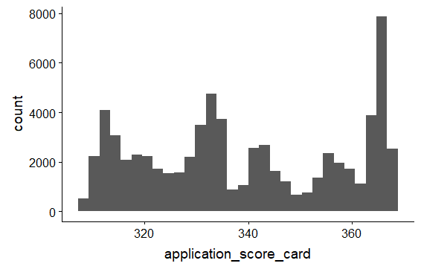
APPLICATION SCORE CARD VALUES
Scores range from 308.3 to 367.9
Mean score of approved customers is 339.3
Low score means increased risk of defaulting
For rejected customers (those with missing Performance Tag in original dataset), scores are in range 314.7 to 331.5.
CUTOFF SCORE FOR ACCEPTING OR REJECTING AN APPLICATION
Cutoff for final Logistic Regression model 0.52
CUTOFF_SCORE 331.25
Number of Applicants above 331.25(ACCEPTED)—43295
Number of Applicants below 331.25(REJECTED)—26569

Slide 32
CALCULATING BANK PROFIT
Confusion matrix can be used to predict the bank’s gain on using the model vs when no model is used
Prediction | No | Yes
No | 42216 | 1079
Yes | 24701 | 1868
Applicants with scorecard greater than 331.25 are filtered
Profit of #2338483691 units to the bank is calculated as profit based on the outstanding balance of non-defaulters using the model.
There were 24701 customers with outstanding balance 31147809012 who did not default and our model suggested otherwise. Assuming 4% earnings on these customers, the bank will potentially lose 1245912360 units.
Potential profit 2338483691 units is much greater than potential loss 1245912360 units.

